Slide 1
Plan for Visitors-Toronto

Slide 2
Contents
Introduction
Data
Method
Execution and Result
Conclusion

Slide 3
Introduction
The fictional Event management company, Rockstars, has to plan the visit of the employees and their families for the purpose of some company wide event.
Use the Data Science methodology and the Four-squares API to find out the best plan they can form to minimize the travelling and maximize the time spent on the activity.

Slide 4
Data
Data is obtained using the Foursquares Location API
The data is grouped by landscape area, and each area included the information about this area .
All information about restaurants, cafes, and stores which in this area.

Slide 5
Method
Find atleast 2 plans for the company to follow.
Steps:
Obtain the data separately for the hotels, restaurants, park, cafeteria.
Cluster the data together to create the map for visualization.

Slide 6
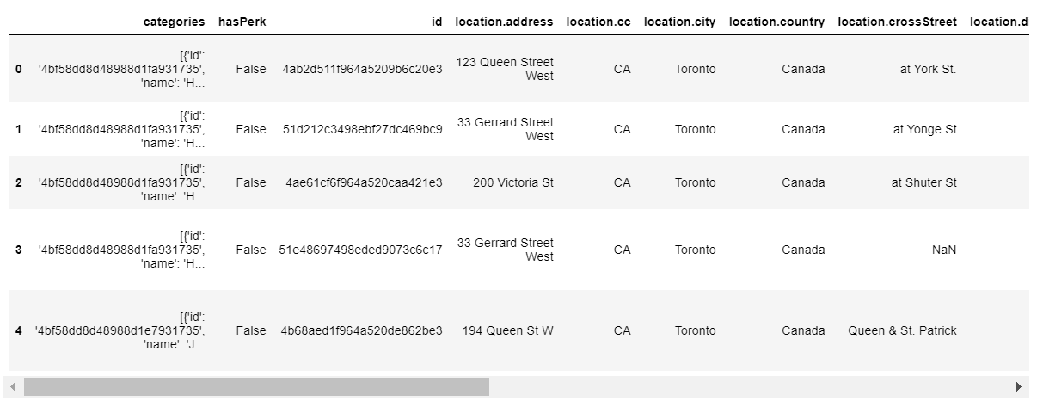
Execution and Result
Steps and Result:
Obtain the location for the hotels in Toronto using foursquare API

Slide 7
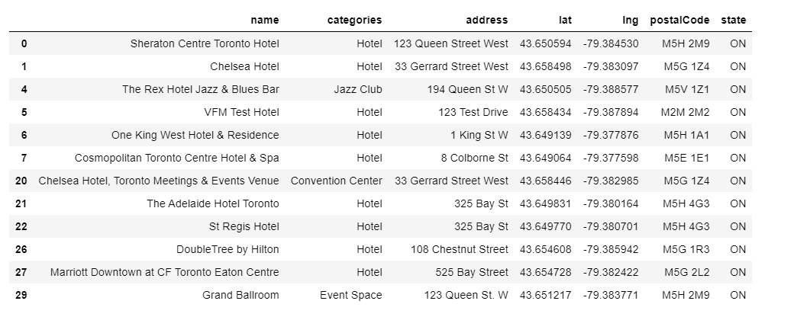
Execution and Result continued
Clean the dataframe to remove the null values and unnecessary columns

Slide 8
Execution and Result continued
Follow the process for all the venues.
Generate the Maps using the Folium.
To do this there are 2 plans
Cafeteria->Park->Hotel
Cafeteria->Shopping Mall-> Hotel

Slide 9
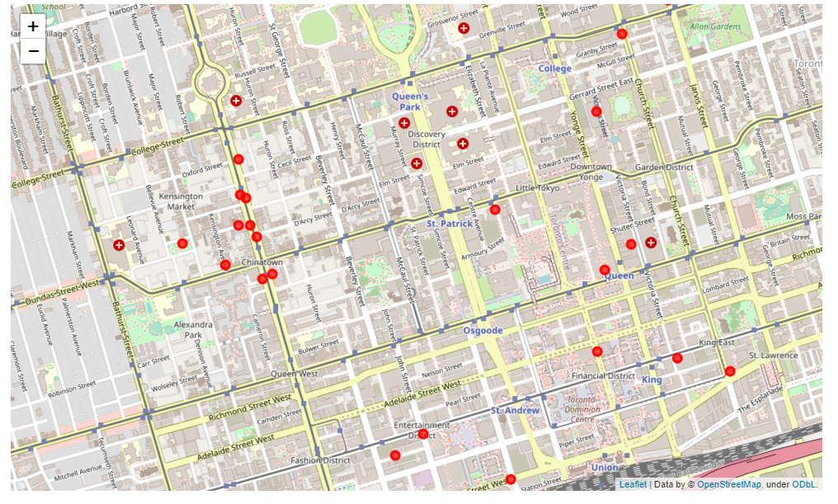
Execution and Result continued
Plan1 Map:

Slide 10
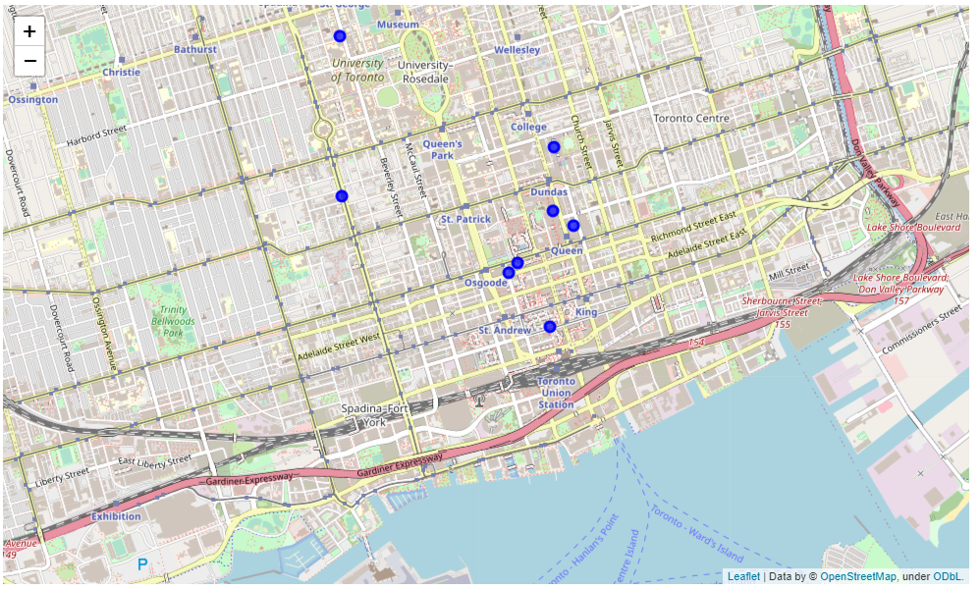
Execution and Result continued
Plan2 Map:

Slide 11
Conclusion
From the cluster maps it is clear that:
Simple and Effective Plan:
Plan1:Cafeteria->Park→Hotel due to the nearness of locations.
Glamarous and Expensive Plan:
Plan1:Cafeteria->Shopping Mall→Restuarant due to the distance of locations.

